Slide 1

Semester Project Robotic assembly of large-scale timber structures
Ibois
Genilloud Florian
18.12.2020
École Polytechnique Fédérale de Lausanne (EPFL)
Ibois
Assistant: Nicolas Rogeau
Professor: Pr. Yves Weinand
Ecole Polytechnique Fédérale de Lausanne

Slide 2
Content
Ibois
Implementation
Vision module
Results
Limitations and Improvements
Conclusion
Ecole Polytechnique Fédérale de Lausanne

Slide 3
Implementation
Ibois
Ecole Polytechnique Fédérale de Lausanne

Slide 4
TOF distances
Ibois
Get the values by using the GPIO pin of the raspi.
Take 50 values for each sensor.
Compute the mean and add these values to the .txt
Compute the Pitch and Roll angle on Unity
Calibrate the laser w.r.t their position on the robot.
4
Ecole Polytechnique Fédérale de Lausanne

Slide 5
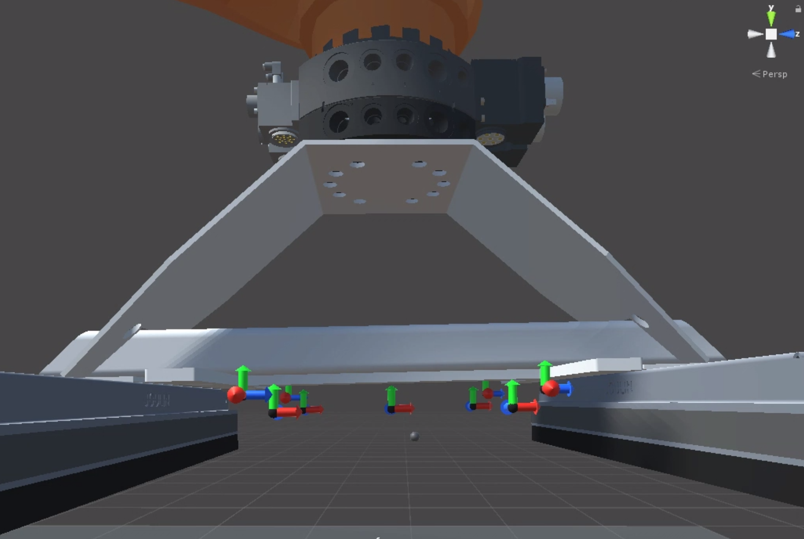
TOF Calibration
Set the position 0 as the position where the plate is fixed on the robot head.
Launch the algorithm 20 times and take the mean.
Subtract this value to each values get by the sensors.

Slide 6
Yaw Angle
Ibois
The yaw angle is computed by using edge detection on the marker.
Transform RGB → Gray
Add some blurring
Increase the contrast
Edge detection using Canny filtering
Extract lines and compute angle using scalar product
As the light intensity may vary, use different threshold to be sure to have accurate results.
6
Ecole Polytechnique Fédérale de Lausanne

Slide 7
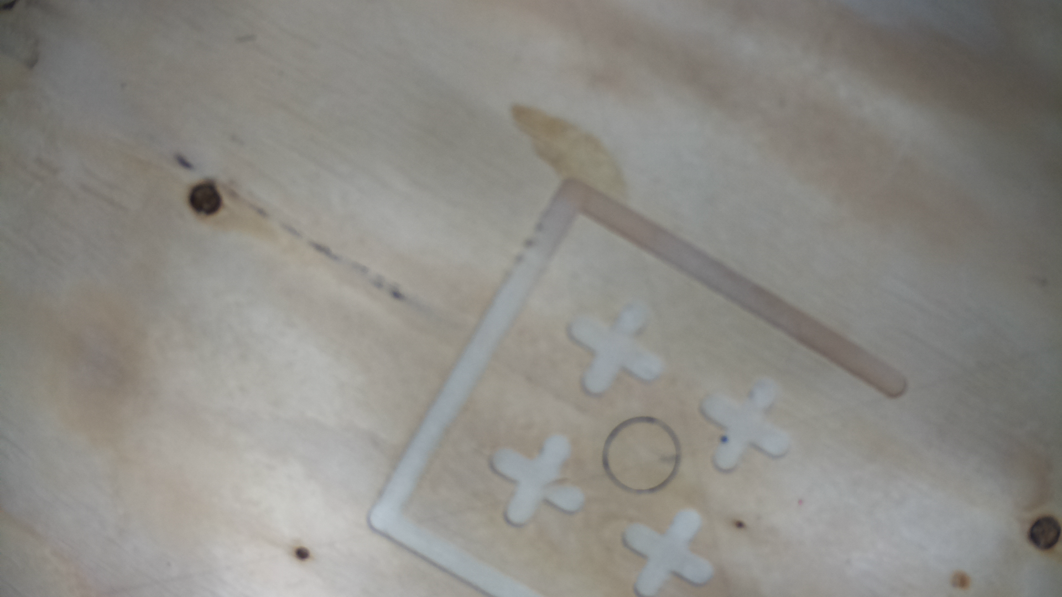
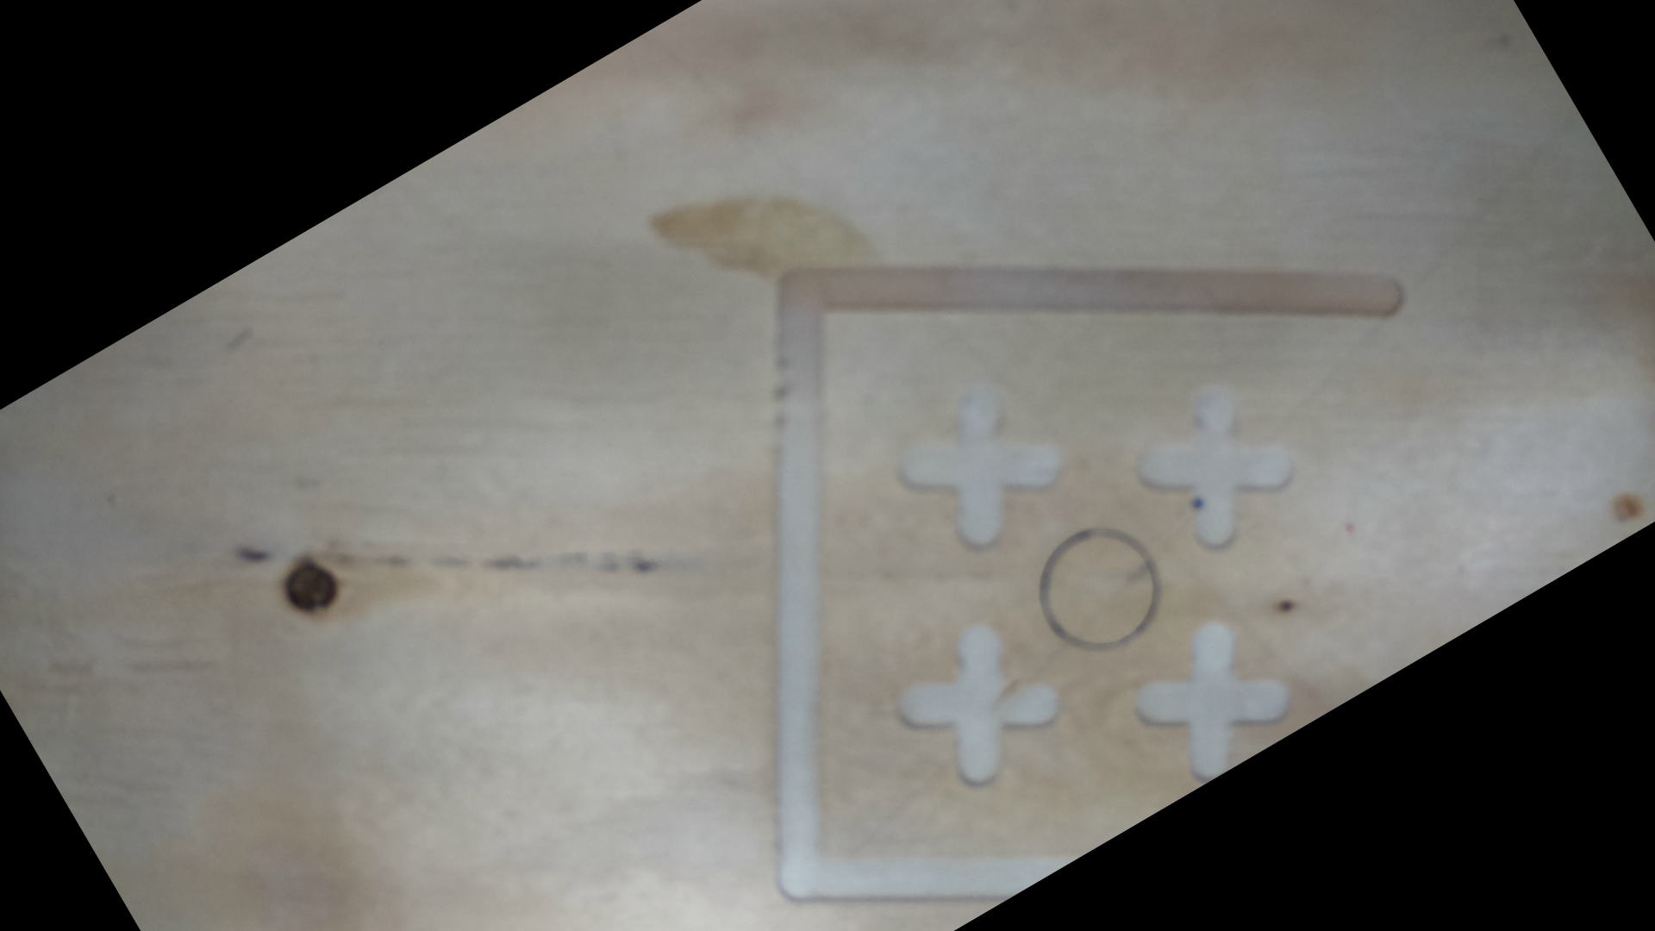
Yaw Angle

Slide 8
Relative position
Ibois
Need to have a reference distance somewhere on the image (fix value).
I used a circle
Transform RGB → Gray
Add some blurring
Increase the contrast
Use Houghcircle function of open-cv
Get center and radius
Use basic 2D transformations to get the X and Y translation distances.
8
Ecole Polytechnique Fédérale de Lausanne

Slide 9
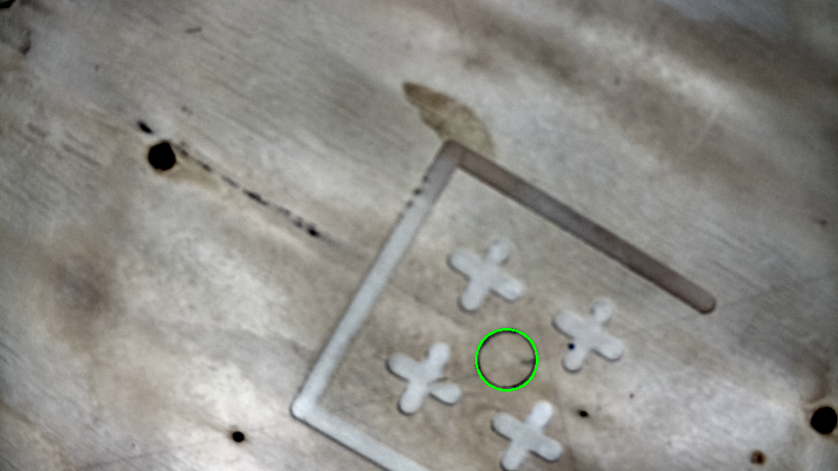
Relative Position

Slide 10
Relative Position
def get_vector(circle_params,img):
circle_R = 18.3 #change the true circle radius here
K = circle_R/circle_params[2]
Ox = img.shape[1]
Oy = img.shape[2]
Dx = -(circle_params[0]-Ox)*K
Dy = -(circle_params[1]-Oy)*K
return Dx,Dy

Slide 11
Data sender
Ibois
First idea was to use a local server on the raspi .
Send data to the server
Get them on the computer
Final implementation use the library paramiko.
The exe file launch the .py files on the raspi
Then we store the output of the .py in a string variable
Write the string content on a .txt file
11
Ecole Polytechnique Fédérale de Lausanne

Slide 12
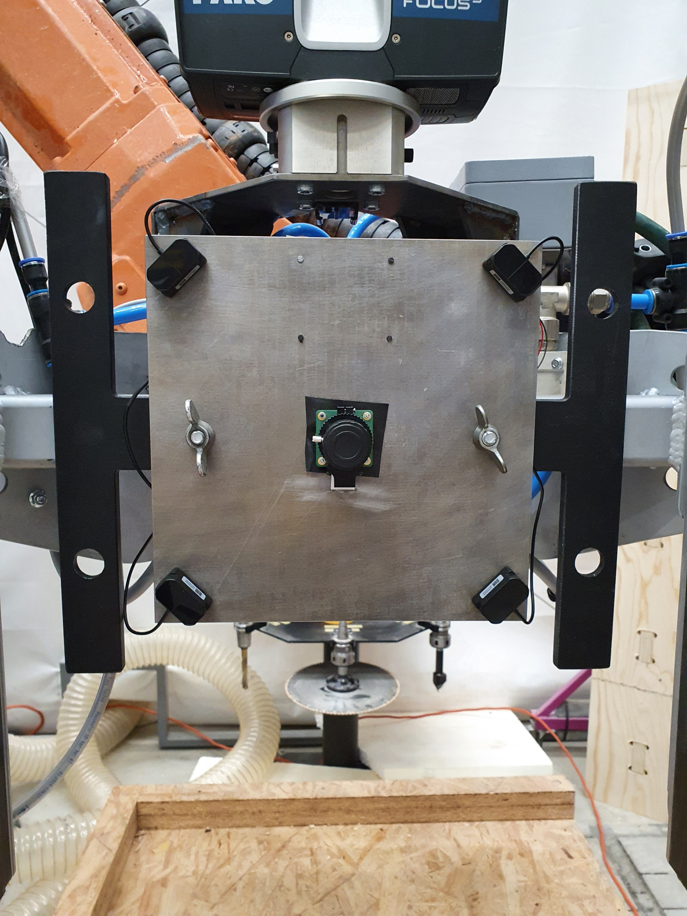
Ibois
12
Ecole Polytechnique Fédérale de Lausanne

Slide 13
Vision module
Ibois
Ecole Polytechnique Fédérale de Lausanne

Slide 14
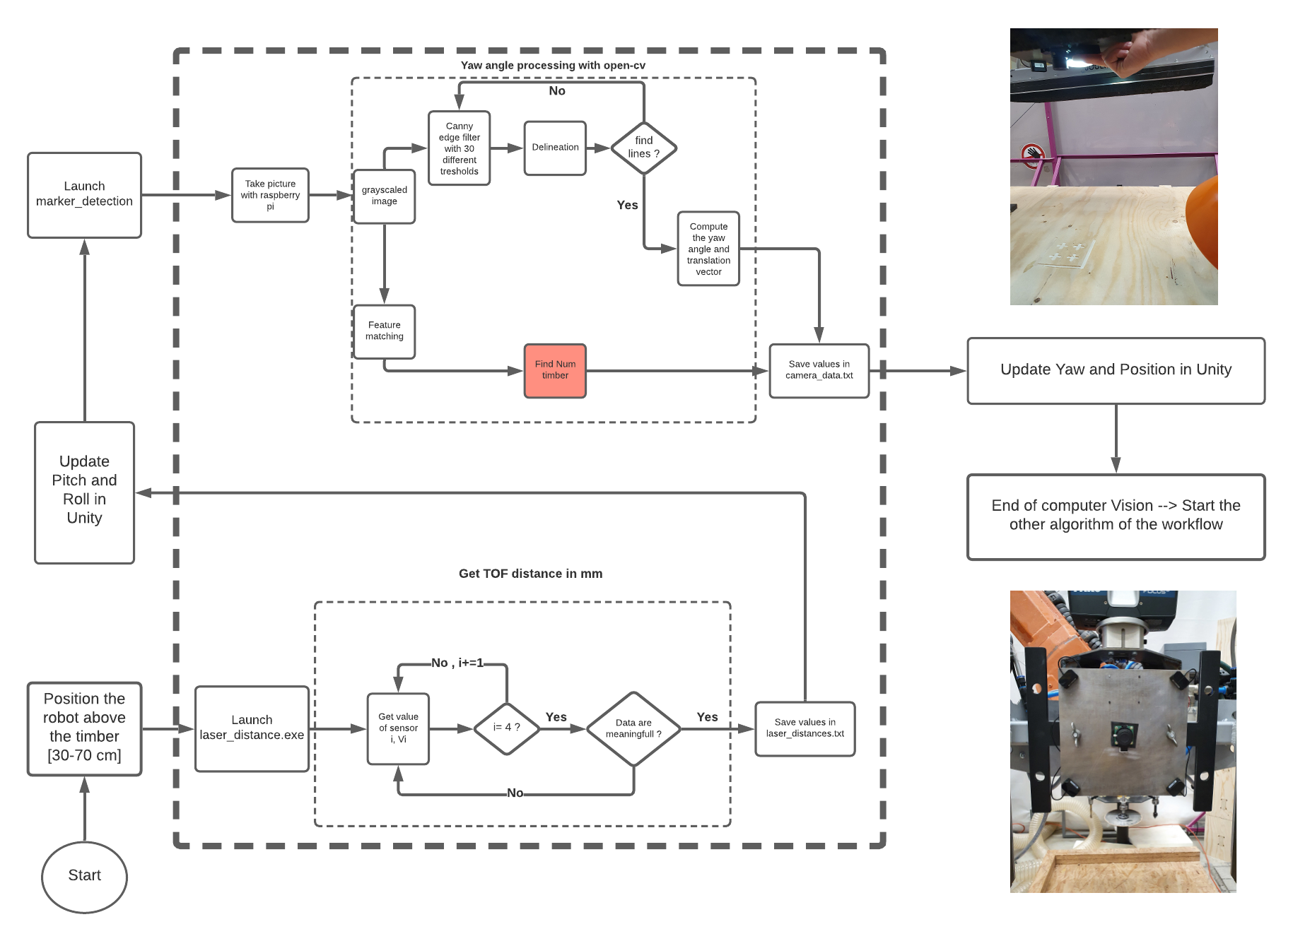
Ibois
14
Ecole Polytechnique Fédérale de Lausanne

Slide 15
Results
Ibois
Ecole Polytechnique Fédérale de Lausanne

Slide 16
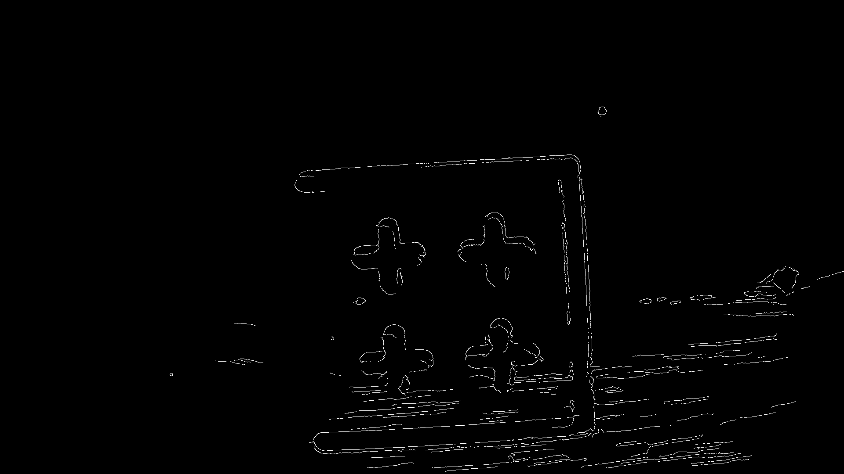
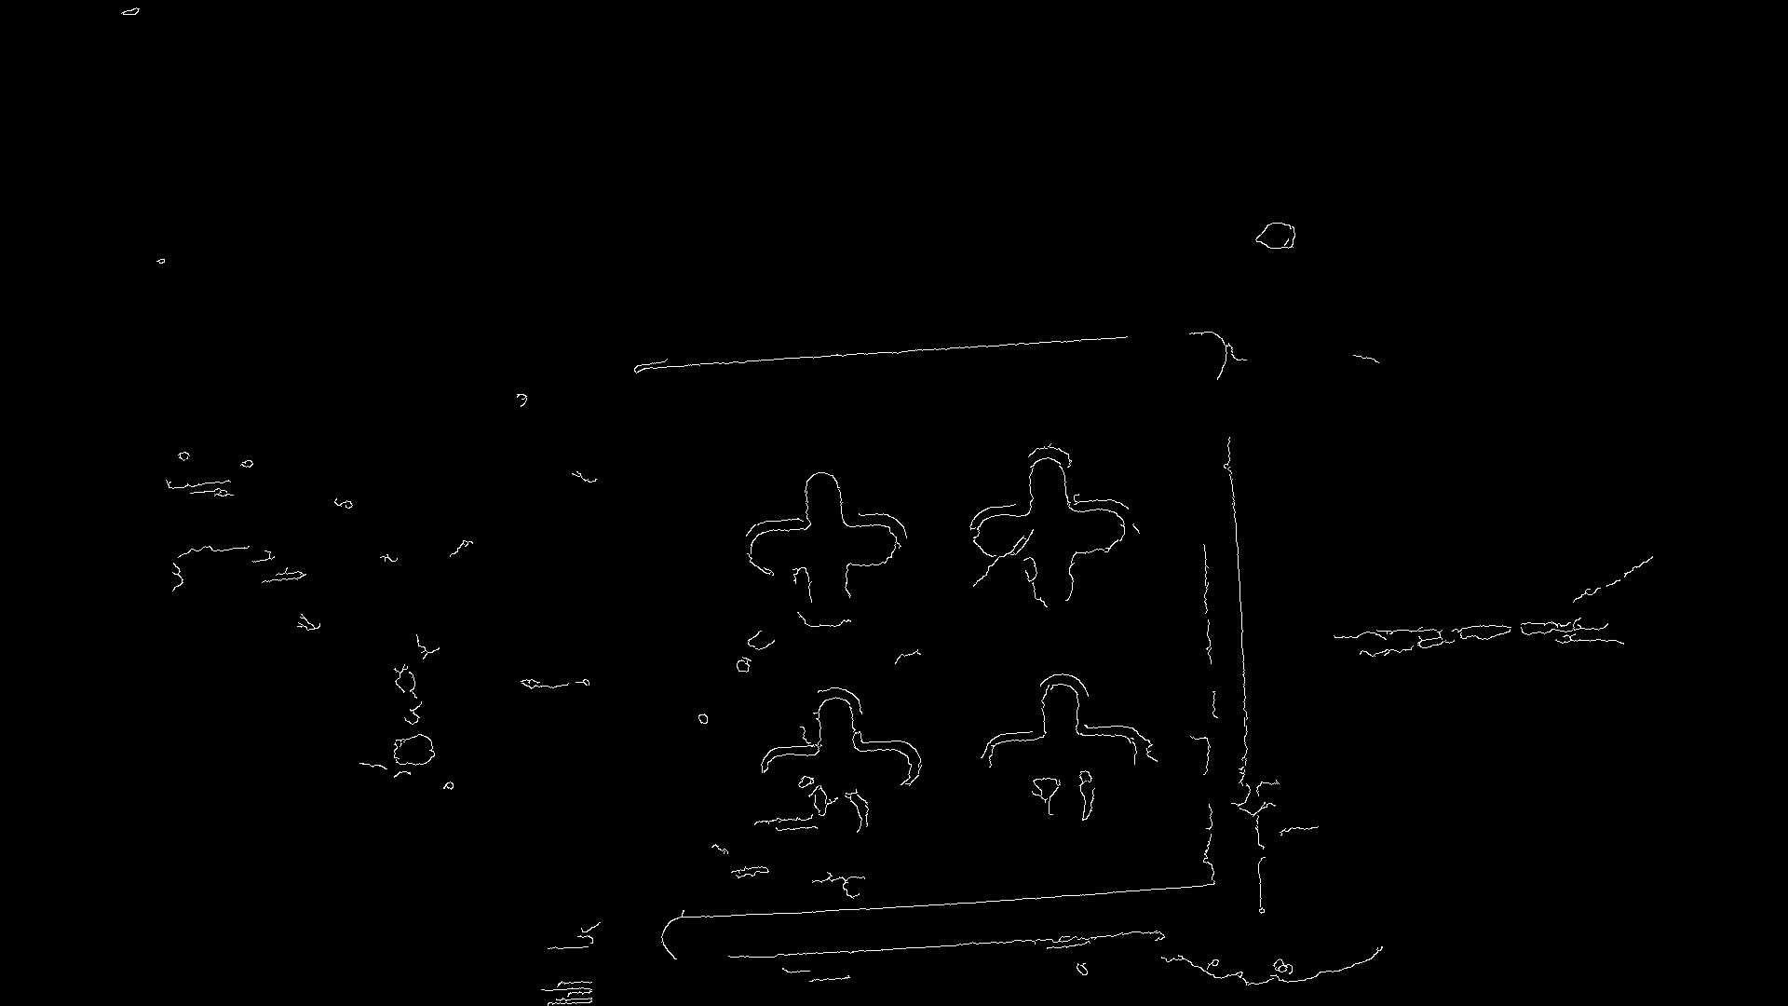
Yaw angle
Ibois
With a light source
Without any light source
16
Ecole Polytechnique Fédérale de Lausanne

Slide 17
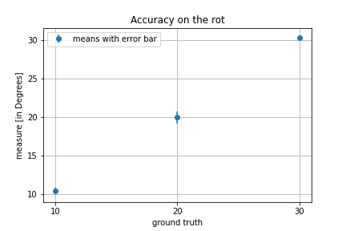
Yaw Angle
Ibois
accuracy is in order of 0.5 degrees.
Can be even more precise with a better marker (arUco)
As I use a lot of threshold, it doesn’t depend on the light.
Really stable and accurate.
17
Ecole Polytechnique Fédérale de Lausanne

Slide 18
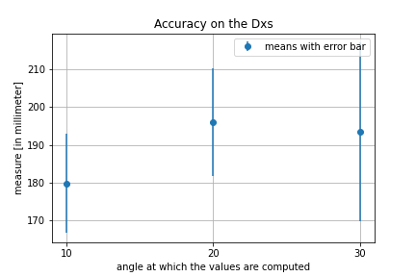
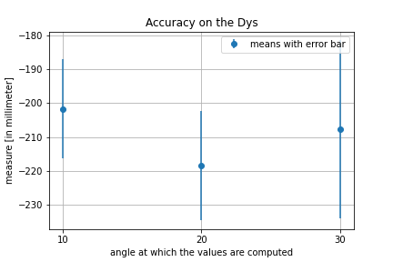
Relative position
Ibois
Distance X
Distance Y
18
Ecole Polytechnique Fédérale de Lausanne

Slide 19
TOF distances
Ibois
The accuracy that I have is about 1 mm ± 0,5mm when we have set the distance to 0.
The precision on the pitch and roll is :
atan(1mm/distance) = ~0,5degree
The surface of the timber needs to be clean before taking the result (it increases the accuracy).
19
Ecole Polytechnique Fédérale de Lausanne

Slide 20
Limitations and Improvements
Ibois
Ecole Polytechnique Fédérale de Lausanne

Slide 21
Execution time
Ibois
The total running time is about 5-6 seconds.
It’s a bit slow.
We can decrease it by:
Send the brute data to the computer
Perform the computation on the computer
Will surely decrease the time of execution
21
Ecole Polytechnique Fédérale de Lausanne

Slide 22
Marker Detection
Ibois
Need to have the marker in range of the camera.
Cannot detect the market with the current implementation.
Need to improve this by changing the marker or the method (maybe go back to arUco for this).
As the CNC cannot cut precise edges, it’s hard to detect shapes.
22
Ecole Polytechnique Fédérale de Lausanne

Slide 23
Relative position
Ibois
The relative position is not that precise and need to be improved
One way to increase the accuracy is to update the position and then, run again the code.
23
Ecole Polytechnique Fédérale de Lausanne

Slide 24
TOF distances
Ibois
Having 1 mm ± 0,5mm accuracy with these cheap lasers is quite impressive
Maybe use different lasers which have better resolution.
24
Ecole Polytechnique Fédérale de Lausanne

Slide 25
Objectives
The detection accuracy of the position is around 1,5mm which is higher than the project objective ( use better TOF lasers to achieve this)
The detection accuracy of the orientation is around 0.5 degree for yaw and 1 degree for pitch and roll ( by changing the marker, it’s maybe possible to achieve the 0,1 degree).

Slide 26
Questions ?
Ibois
Robotic assembly of large-scale timber structures
Thank you for you attention
Ecole Polytechnique Fédérale de Lausanne

